Slide 1
MEETING THE CHALLENGE OF DIABETES IN CHINA
Guilhem Fabre, Université Paul Valéry
Zhen Luo, New York University
Victor Rodwin, New York University

Slide 2
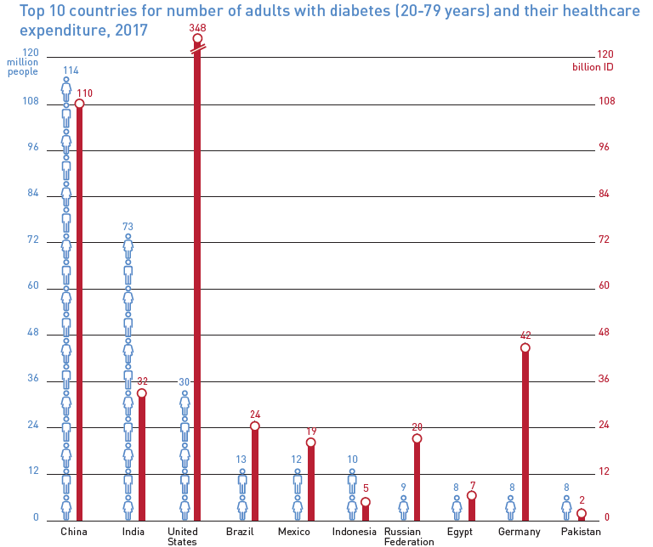
TOP TEN COUNTRIES FOR DIABETES : China, India, USA, Brazil, Mexico…
Source: International Diabetes Atlas, 2017.

Slide 3
PREVALENCE OF DIABETES IN CHINA AND US
China:
Diabetes: 10.9%
Prediabetes: 35.7%
US:
Diabetes 12-14%
Prediabetes: 33.9%
Limin Wang et al. 2017. Prevalence and Ethnic Pattern of Diabetes and Prediabetes
in China in 2013. JAMA. ;317(24):2515-2523 & US CDC

Slide 4
PREVALENCE OF DIABETES IN CHINA AND US
Source: Cheng Hu and Weiping Jia « Diabetes in China : Epidemiology and Genetic Risk Factors and Their Clinical Utility in Personnalized Medication », Diabetes 2018 : 67 : 3-11.

Slide 5
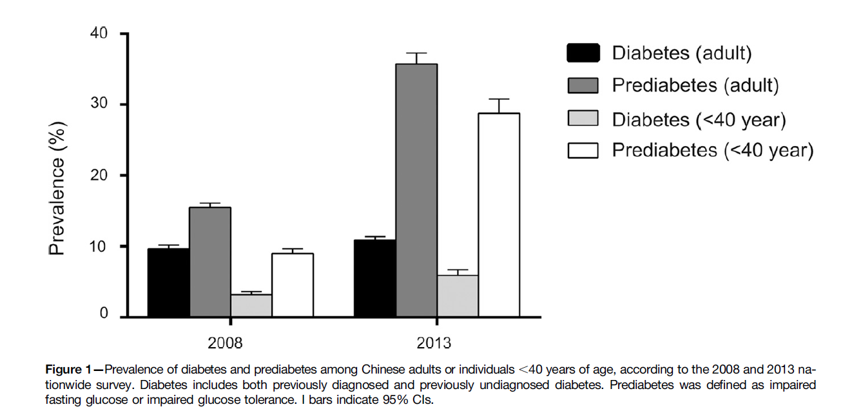
DIABETES & PREDIABETES AMONG CHINESE ADULTS, 2008-2013
Source: Hu, C., & Jia, W. (2018). Diabetes in China: epidemiology and genetic risk factors and their clinical utility in personalized medication. Diabetes, 67(1), 3-11.

Slide 6
DIABETES PREVALENCE BY PROVINCE 2013
Source: Zhou, M., Astell-Burt, T., Bi, Y., Feng, X., Jiang, Y., Li, Y., . . . Wang, L. (2014). Geographical variation in diabetes prevalence and detection in China: multilevel spatial analysis of 98,058 adults. Diabetes care, DC_141100.

Slide 7
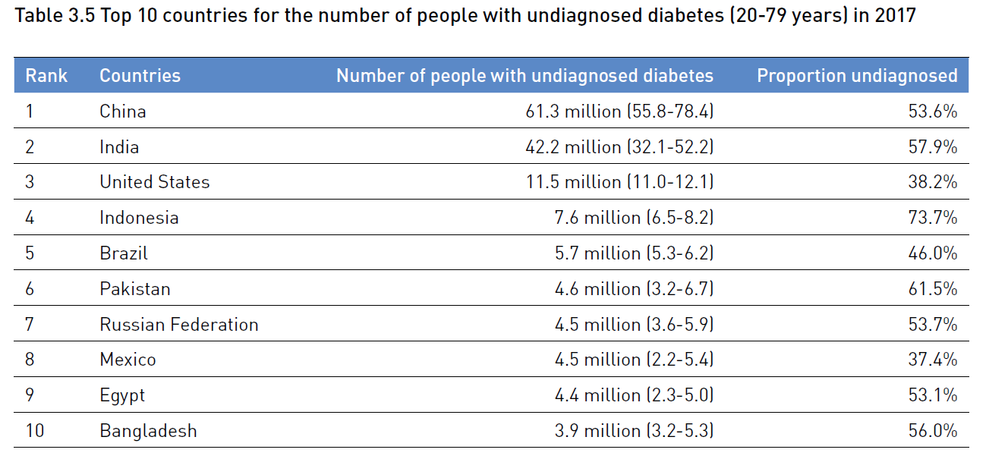
TOP TEN COUNTRIES FOR UNDIAGNOSED DIABETES , 2017
Source: International Diabetes Atlas, 2017.

Slide 8
DIABETES DETECTION AMONG CHINESE PROVINCES , 2013
Source: Zhou, M., Astell-Burt, T., Bi, Y., Feng, X., Jiang, Y., Li, Y., . . . Wang, L. (2014). Geographical variation in diabetes prevalence and detection in China: multilevel spatial analysis of 98,058 adults. Diabetes care, DC_141100.

Slide 9
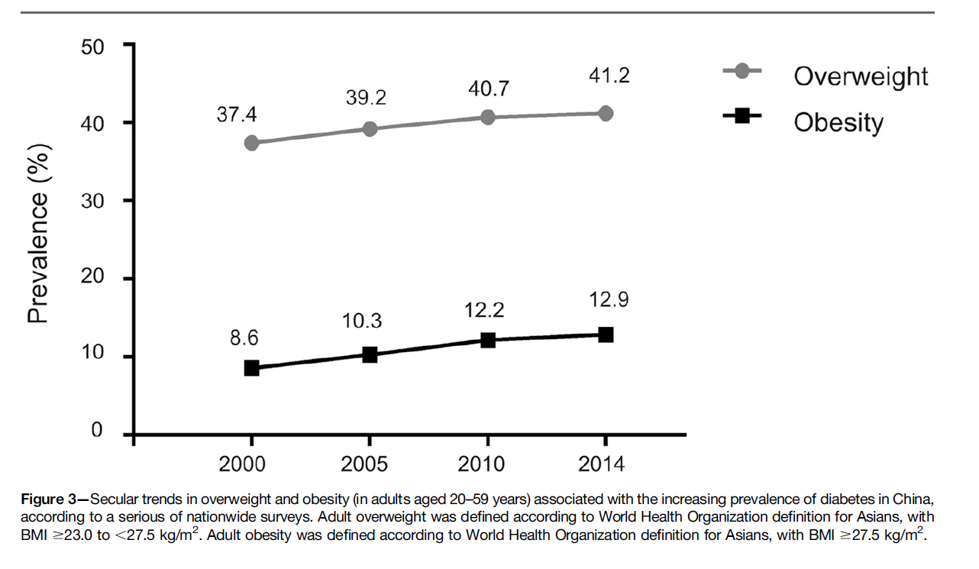
OVERWEIGHT & OBESITY AMONG CHINESE ADULTS, 2000-2014
Source: Hu, C., & Jia, W. (2018). Diabetes in China: epidemiology and genetic risk factors and their clinical utility in personalized medication. Diabetes, 67(1), 3-11.

Slide 10
CHILD OBESITY = 10 % between 7 and 12 years in SHANGHAI
Jeanette Wang. “Explosion in childhood obesity in China ‘worst ever’, expert says of new study findings”. South China Morning Post, April 27th, 2016.

Slide 11
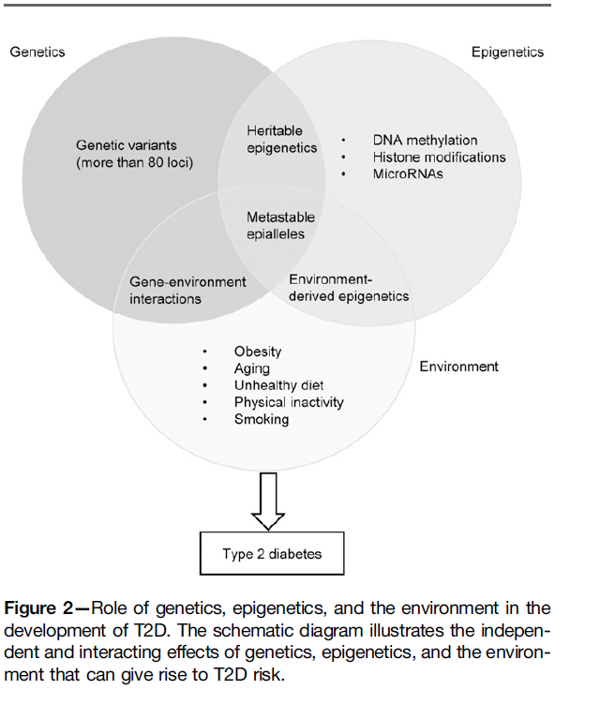
GENETIC & ENVIRONMENTAL FACTORS FOR TYPE 2 DIABETES
Source: Hu, C., & Jia, W. (2018). Diabetes in China: epidemiology and genetic risk factors and their clinical utility in personalized medication. Diabetes, 67(1), 3-11.

Slide 12
HOW TO TACKLE THE CRISIS
Upstream: National Demonstration Areas for Non-communicable Disease Prevention and Control.
Downstream: Medical Partnership.

Slide 13
NATIONAL DEMONSTRATION AREA (NDA)’S FRAMEWORK
County-level administrative areas.
250 counties, 9.29% of the total number.
Diabetes detection rate: 79.54% versus the 44% national rate.
“Directed improvisation”.
Central government: General framework.
Local government: Specific solutions.

Slide 14
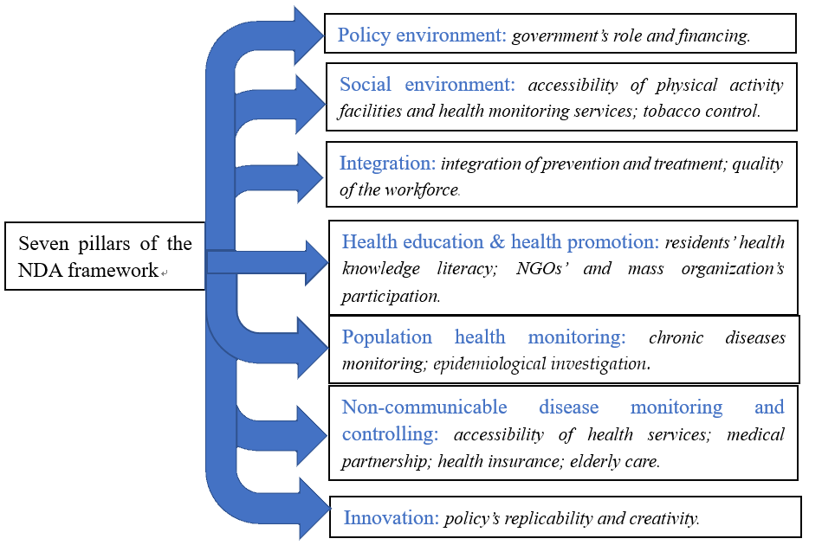
NATIONAL DEMONSTRATION AREA (NDA)’S FRAMEWORK
The county government should evaluate itself according to the framework before applying to become NDA. Once accepted, the central finance will subsidize the county government to further promote population health.

Slide 15
DIABETES CONTROL NDAs BY REGIONS
Source: Jin, R., Li, J., Zhang, J., Li, J., Bian, F., Deng, G., . . . Jiang, Y. (2018). Management programs on diabetes among Chinese adults in the National Demonstration Areas for Comprehensive Prevention and Control of Non-communicable Diseases Chinese Journal of Epidemiology, 39(4), 407-411.

Slide 16
ADDRESSING BOTTLENECKS IN THE HOSPITAL SYSTEM: STATUS QUO
Meng Qingyue, Roadmap to a healthy China : integrating the delivery of medical care » p.19-27, in Matthis Tepan & Jane Ducket (Editors), Serve the people : Innovation and IT in China’s social devlopment agenda, Mercator Institute for China Studies, Papers on China, No 6, October 2018.

Slide 17
PLAN TO REDUCE BOTTLENECKS, 2018
Meng Qingyue, Roadmap to a healthy China : integrating the delivery of medical care » p.19-27, in Matthis Tepan & Jane Ducket (Editors), Serve the people : Innovation and IT in China’s social devlopment agenda, Mercator Institute for China Studies, Papers on China, No 6, October 2018.

Slide 18
HEALTH WORKFORCE
Source： The Challenge of Non-communicable Diseases (NCDs) in China Government Responses and Opportunities for Reform.
Tsung-Mei Cheng
China’s Healthcare System and Reform. Lawton R. Burns and Gordon G. Liu

Slide 19
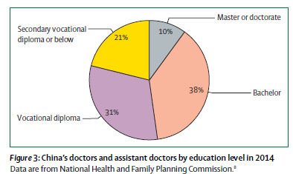
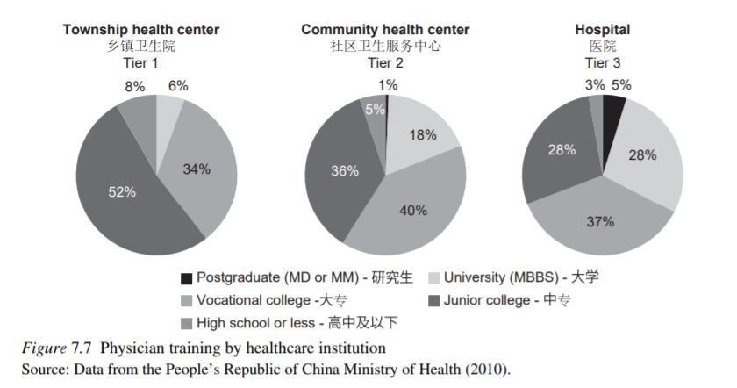
HEALTH WORKFORCE
Doctors in China: improving quality through modernisation
of residency education.
Jiming Zhu, Wenkai Li, Lincoln Chen. Lancet, June 2016
China’s Physician and Nurse Workforce.
Lawton Robert Burns

Slide 20
MEDICAL PARTNERSHIP
Integrate community clinics and big central hospitals.
Not only patients, but also physicians, can move upward or downward in this system.
Beijing and Shanghai. Conflicts of interest.

Slide 21
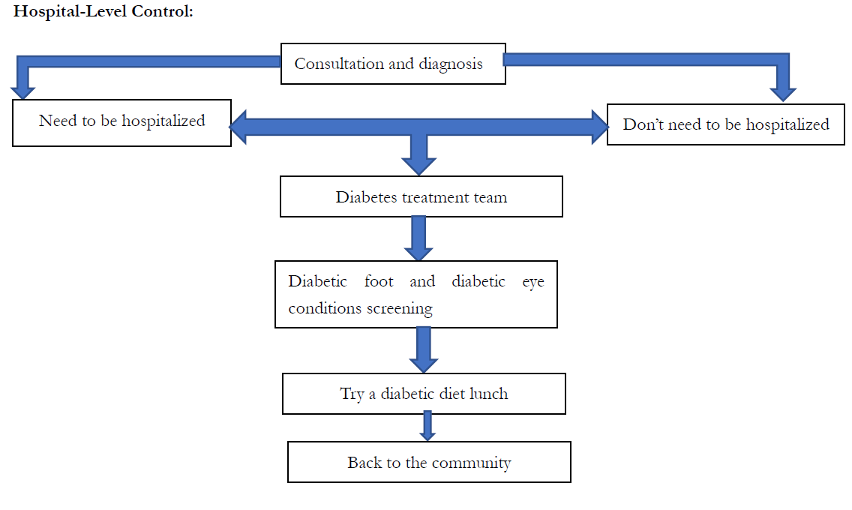
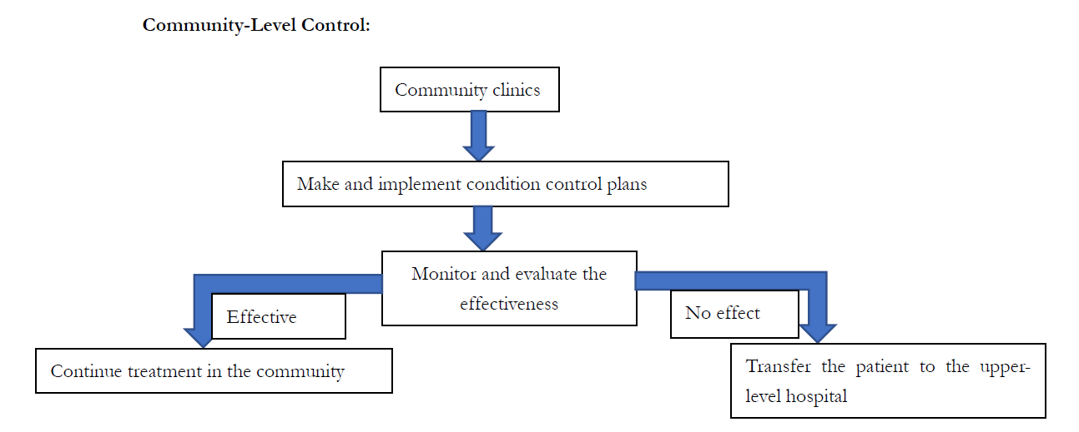
MEDICAL PARTNERSHIP Community Clinics and Hospitals
Source: Prof. Jia Weiping’s presentation on the 2016 China-Japan Endocrine and Metabolic Diseases Forum (2016中日内分泌代谢疾病临床与实践会议). Zheng Min: Prof. Jia Weiping: Diabetes Control and Shanghai’s Hierarchical Medical System Model. https://www.cn-healthcare.com/article/20161024/content-486605.html

Slide 22
PROBLEMS
Physicians are unwilling to move downward.
Patients’ preferences are hard to change.
“Brain drain”.
Chaoyang Hospital’s experience: 2796 patients were transferred down to community clinics, while only 197 patients were referred up to the central hospital.

Slide 23
RECENT & FUTURE INNOVATIONS TO HELP PEOPLE LIVING WITH DIABETES
G .Fagherazzi, P. Ravaud, « Digital Diabetes : Perspectives for diabetes prevention, management and research », Diabetes Metab (2018) : https://www.sciencedirect.com/science/article/pii/S126236361830171X?via%3Dihub

Slide 24
I.T & AI IN DIABETES RESEARCH, PREVENTION & MANAGEMENT
G .Fagherazzi, P. Ravaud, « Digital Diabetes : Perspectives for diabetes prevention, management and research », Diabetes Metab (2018) : https://www.sciencedirect.com/science/article/pii/S126236361830171X?via%3Dihub

